Slide 1
Global Health Cluster Orientation Package

Slide 2
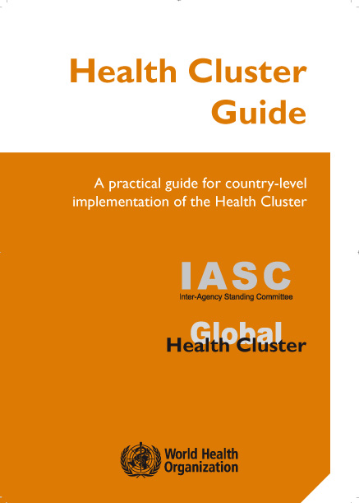
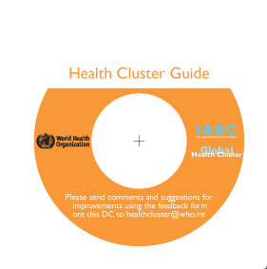
The Health Cluster Guide
The Global Health Cluster has developed a practical guide for country-level implementation of the Health Cluster
Available in English and French:
www.who.int/hac/global_health_cluster/guide
        online
        hard copy
        CD/ROM
Notes:
World Health Organization

Slide 3
What is a “Cluster”?
  A group of agencies (international & national) that are interconnected by their respective mandates, and that come together around a set of humanitarian interventions in a common area, for purposes of synergies, surge, effectiveness, efficiency, and accountability.

Slide 4
The role of a Cluster is to:
  Identify and address gaps
  Strengthen humanitarian partnerships
  Ensure predictability and accountability by clarifying the division of labour among agencies, and making the humanitarian community more accountable

Slide 5
The Health Cluster does this by:
  Improving the predictability, timeliness, effectiveness of a response
  Improving accountability
  Preparing recovery efforts
  Setting higher standards
  Providing global support

Slide 6
The Health Cluster
Operates at:
  Global level
  Country level - in some contexts at national and sub-national level

Slide 7
The Global Health Cluster
    Forum of the Inter Agency Standing Committee (IASC) and comprised of key international health entities mandated to build global humanitarian response capacity
    The WHO is the lead agency and is accountable to the Emergency Relief Coordinator

Slide 8
The Global Health Cluster
  Made up of 39 full members and 4 observers
  Two Working Groups made up of partners and co chaired by WHO and an international NGO:
      Technical – development of guidance and tools, country support missions, Health Cluster Coordinator Training
      Policy and Strategy - development of position papers on User Fees, Civil /Military Collaboration

Slide 9
The Global Health Cluster
  Builds consensus on humanitarian health priorities and related best practices, and strengthen system-wide capacities to ensure an effective and predictable response by ………..
Strategy and planning at global level
Providing guidance and tools, and standards and policies
Establishing systems and procedures for the rapid deployment of experts and supplies
Building global partnerships to implement and promote this work

Slide 10
Members of the Global Health Cluster
UN Partners
FAO
UNFPA
UNHCR
UNICEF
Non-UN Partners
African Humanitarian Action
American Refugee Comm
CARE
Catholic Relief Service
Centers for Disease Control
Columbia
Concern Worldwide
ECHO
Handicap Intl
Harvard
Help Age Intl
IFRC
IOM
ICMH
Intl Council of Nurses
Intl Medical Corps
Intl Rescue Committee
Johns Hopkins
Medecins du Monde
Merlin
OFDA
Save the Children, US/UK
Terre des Hommes
WADEM
Women's Commission
World Vision International
Observer
ICRC
Interaction
MSF
Sphere Project

Slide 11
Health Cluster Activation
AFRO (10)
Burundi
CAR
Chad
Côte d'Ivoire
DRC
Eritrea
Ethiopia
Sudan
Guinea
Kenya
Liberia
Niger
Uganda
Zimbabwe
EURO (2)
Georgia
Tajikistan
EMRO (6)
Afghanistan
Iraq
OPT (Palestine)
Pakistan
Somalia
Sudan
Yemen
PAHO (2)
Colombia
Haiti
SEARO (5)
Indonesia
Myanmar
Nepal
Sri Lanka
Timor-Leste

Slide 12
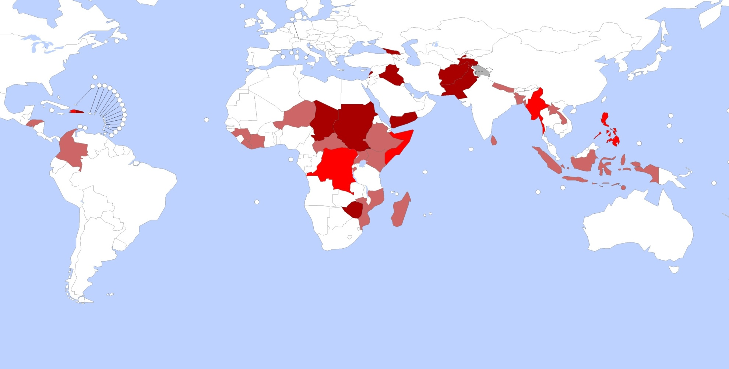
Health Cluster Activation
Dedicated HCC
Afghanistan, Chad, Dominican Republic, Georgia, Iraq, Lebanon, occupied Palestinian territory, Pakistan, Sudan, Tajikistan, Yemen, Zimbabwe
Dedicated HCC with NGO involvement in coordination
Democratic Republic of the Congo, Haiti, Myanmar, Somalia, Philippines
Double hatter HCC
Bangladesh, Burundi, Central African Republic, Colombia, Côte d'Ivoire, El Salvador, Ethiopia, Guinea, Honduras, Indonesia, Kenya, Lao People's Democratic Republic, Liberia, Madagascar, Mozambique, Nepal, Niger, Samoa, Sri Lanka, Timor-Leste, Uganda
Source WHO: The boundaries and names shown and the designations used on this map do not imply the expression of any opinion whatsoever on the part of the World Health Organization concerning the legal status of any country, territory, city or area or of its authorities, or concerning the delimitation of its frontiers or boundaries. Dotted lines on maps represent approximate border lines for which there may not yet be full agreement.

Slide 13
The Health Cluster at country level
The Health Cluster can be activated in a country with a Humanitarian Coordinator in case of a sudden major new emergency requiring a multi-sectoral response.
The humanitarian architecture is complex!

Slide 14
RC/HC
Government
Non – State Actors
M
O
H
Humanitarian Country Team
UN
Country
Team
OCHA
Designated Health Cluster Lead Agency
Health Cluster
Coordinator
Lead Agency
Country Rep
Health Cluster
Emergency
Health
Officer
Inter-cluster coordination group

Slide 15
The Health Cluster at county level
At country level the Health Cluster is a mechanism for participating agencies to:
  work in partnership
  harmonize efforts and use available resources efficiently
  use agreed objectives, priorities and strategies

Slide 16
The Principles of Partnership
  Equality
  Transparency
  Result-oriented approach
  Responsibility
  Complementarity

Slide 17
The ten functions of the Health Cluster at country level
Coordination mechanisms and inclusion of key actors within the Health Cluster and inter-cluster forums
Relations with other key stakeholders
Needs assessment, situation monitoring & analysis, including identifying gaps in health response
Strategic development and gap filling
Contingency planning
Application of standards
Training and capacity building, including emergency preparedness
Monitoring and reporting
Advocacy and resource mobilisation
Provider of last resort (POLR)

Slide 18
Roles and Responsibilities
  Government
  Cluster Lead Agency (CLA)
  Health Cluster Coordinator (HCC)
  Partners (NGOs, Civil Society, UN agencies, Donors)

Slide 19
Roles and Responsibilities:
Government & State Institutions
  Depends on the willingness or capacity
  But need to remember that ownership should be with the host state
  If the MoH is in a strong position, the cluster should organize the response in support of the host government’s efforts
  In some contexts the MoH representative and the Cluster Lead Agency co-chair Health Cluster meetings at both national and sub-national levels

Slide 20
Roles and Responsibilities:
The Health Cluster Lead Agency WHO
  Acts as a bridge between national and local health authorities and international heath actors
  Ensures that health actors in humanitarian response build on local capacities
  Ensures establishment of effective coordination mechanisms
  Mobilises and deploys technical and human resources and stockpiles
  Acts as the Provider of Last Resort (POLR)

Slide 21
Roles and Responsibilities:
Health Cluster Coordinator
  Enables collaboration between partners
  Provides strategic leadership
  Facilitates cluster activities
  Ensures needs and risk assessments are carried out, gaps are identified and information is shared
  Generate consensus
  Ensures integration of cross cutting issues
  Ensures coordination with other clusters
  Role is to facilitate and lead not to direct

Slide 22
Roles and Responsibilities:
Health Cluster Partners
  Commit to the aims of the Health Cluster
  Proactively exchange information
  Mobilize resources and build local capacity
  Share responsibilities for Health Cluster activities, may act as Co Steward
  Respect and implement Health Cluster principles, policies and standards

Slide 23
Roles and Responsibilities:
Working in Partnership
  Critical for the effective implementation of the Health Cluster
  An effective partnership is inclusive, complements and strengthens existing coordination structures and processes at national and sub national level
  Starts with realistic and achievable objectives
  Ensures all partners have something to gain
  Listens to other partners and learns from the past
  Ensures transparency in all cluster activities

Slide 24
Resources
Health Cluster Guide www.who.int/hac/global_health_cluster/guide
Humanitarian Reform
www.humanitarianreform.org
Position Paper on User fees http://www.who.int/hac/global_health_cluster/about/policy_strategy/EN_final_position_paper_on_user_fees.pdf

